Slide 1
COMP 3617
Week 9

Slide 2
Services
Android component for performing long running operations
Runs in background
Does not provide a user interface
Can be exposed to other apps
Continue to run even if the user switches to another application
Suited to repetitive, long running tasks like playing audio in the background, web uploads, checking for new data, etc

Slide 3
Services
Can be started by another app component like an activity via a call to startService()
Once started, service runs in the background indefinitely
A service started in this manner does not return a result to the caller
Typically when the operation is completed, the service shuts itself down
Service runs in the main thread of its hosting process along with the activities

Slide 4
Services
Services run on the UI thread
Service does not automatically entail a separate background thread or process
Long running operations in Services can lead to ANRs
Ideally services should spawn a separate thread to perform the action so as not to tie up the UI thread

Slide 5
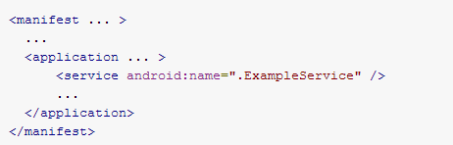
Services
A Service has to be declared in the manifest file

Slide 6
Service vs AsyncTask/Thread
If you need to perform a short one-off tasks when the user is interacting with the app, then you should create an async task/thread
Services are meant to run in the background, independent of the activity that is currently open, even when the user is not interacting with the app
Since Service run on the main UI thread by default, you should create a new thread within the service to perform the long running task

Slide 7
Service vs AsyncTask/Thread
Services reduce the risk of memory leaks
Thread can be interrupted when Android shuts down the process – leaving the thread in an indeterminate state
Service has a life cycle and it can be controlled by a background thread – there by the Service can be active while the background thread is active providing a better lifecycle control
Services can be exposed to other apps

Slide 8
Creating & Starting a Service
You create service by extending the Service class
There is an abstract onBind method – used for Bound services (just return a null as we are not focusing on Bound Services)
The service can be started by creating an explicit intent and calling startService (on the activity) with the intent
The service can be stopped in the same manner as above except the method is called stopService

Slide 9
Service Lifecycle
Service has a lifecycle – quite simple from Activity
onCreate – when the service is initially created
onDestroy – when the service shuts down
onStartCommand – called when the client calls startService with an intent
To stop a service from within the service class itself, it can call stopSelf()

Slide 10
Types of Service
Started Service – Created by Start request and destroyed by Stop request. Start requests pass data to the Service. Example of services we cover in this lecture
Bound Service – Created when an Android component binds to the service and destroyed when all the components are unbound from it. Advanced topic, we will not be covering this.

Slide 11
Intent Service
A service that maintains a queue of intents
Executes one intent at a time in a worker thread
Ideal for many background tasks where the UI dispatches work but does not require immediate response
Allows for clean separation of concerns and code – for instance all networking code is managed by the intent service
Any other scenario where you don’t need a permanent always on service

Slide 12
Intent Service
An intent service’s intents are commands
Each command can tell the service to do something specific
It is started upon receiving the first command
Calls onHandleIntent(intent) method on the background thread for each intent
Commands are put on a queue
Where there are no commands to process the queue, the service stops and is destroyed

Slide 13
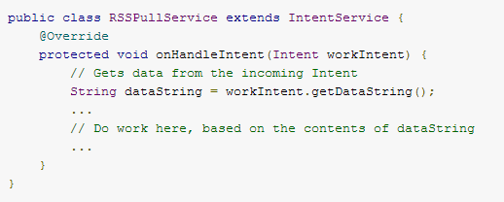
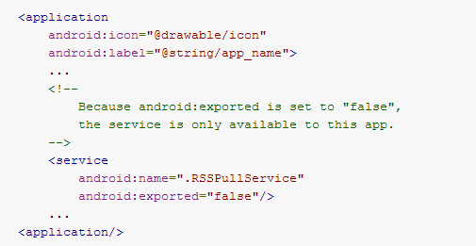
Intent Service

Slide 14
Broadcast Receiver
Application Component in Android
Enable apps to receive intents that are broadcast by the system, components in the app or other apps
Receives broadcast intents even if other components of the app are not running
Two ways to make a broadcast receiver known to the system
Declare in the manifest file
Create the receiver dynamically in code and register with registerReceiver() method

Slide 15
Broadcast Receiver
When registering a receiver dynamically in an activity, it is typically registered in onResume() call and unregistered in onPause() call
Broadcast Receiver object is valid for the duration of the call to onReceive
Once onReceive() returns, the receiver object is no longer active
Broadcast Receivers run on the main UI thread and should finish off their operation within 10 seconds

Slide 16
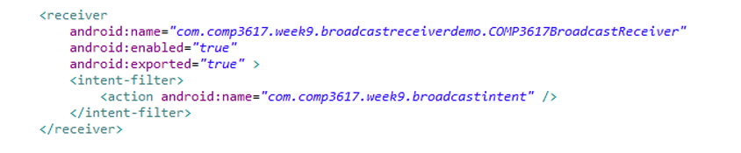
Registering Broadcast Receiver
Uses receiver tag in the Manifest file

Slide 17
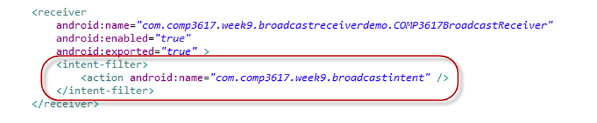
Intent Filters
Allow Broadcast Receivers to specify the actions it is interested in receiving

Slide 18
System related Broadcast Events
Action | Description
ACTION_TIME_TICK | Current time has changed. Sent every minute
ACTION_TIME_CHANGED | Time has been set
ACTION_TIMEZONE_CHANGED | Timezone has changed
ACTION_BOOT_COMPLETED | System has finished booting
ACTION_PACKAGE_ADDED | A new application package has been installed on the device
ACTION_PACKAGE_REMOVED | An application package has been removed
ACTION_BATTERY_CHANGED | Battery’s charging state or level has changed
ACTION_POWER_CONNECTED | Power has been connected to the device
ACTION_POWER_DISCONNECTED | Power has been disconnected
ACTION_SHUTDOWN | Device is about to shut down
The above intent actions are defined in android.content.Intent class

Slide 19
Broadcast Intents
Android system broadcasts intents to signal changes
Your app can tap into many of these events to add functionality
To receive the broadcast intents, the app has to request permission

Slide 20
Notification
When using services most often they don’t require user intervention
In some cases there might require a mechanism to notify the user about something and let the user take action
Android supports multiple notification mechanisms – Status bar, Vibrating, Blinking lights (depending on the device)
Most common one is using the status bar and we will cover that here

Slide 21
Notification with Status Bar
Notifications are created using NotificationManager system service
NotificationManager takes a notification object to notify
Notification object contains
An icon
Ticker text
Notification title and body text
A Pending intent

Slide 22
Notification Action
A notification in the status bar can optionally trigger an activity in your app
This allows the user to react to the notification
The action is described by a “Pending” intent
A pending intent describes the action to be performed on your app’s behalf
A pending intent is given to other apps or Android system to trigger an action as if it was triggered by your app

Slide 23
NotificationBuilder
In Android 3.0 and above, there is a Notification.Builder class that can be used to build notifications
Parameters to the notification are specified using the builder pattern and calling the build() method returns the Notification instance

Slide 24
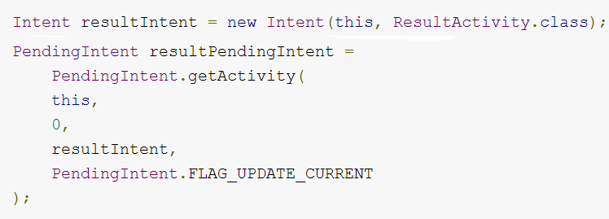
Pending Intent
Describes an intent and the target action to perform with it
To create a pending intent, you create an intent as you would normally do and wrap it with a pending intent via a static method of PendingIntent class

Slide 25
Pending Intent
In the previous example when the notification contains the action to refer to the pending intent, it would launch the ResultActivity
Pending activities are used by Android system components such as AlarmManager, NotificationManager etc when the system has to call into app specific functionality when certain events happen

